Slide 1
Milliken Taulia Portal Overview for Suppliers
February 2015

Slide 2
Overview: The New Milliken Supplier Portal - Taulia
Benefits to the Supplier
Invoice status
Payment details
PO visibility
Invoice creation and submission
Vendor Master Updates
Messaging features
Opportunity to accelerate payments
= FREE to Supplier
Replaces old vendor portal – “Milliken Connect”
Overview of portal: http://supplier.taulia.com/customers/milliken/
Taulia Knowledge Database (FAQ’s, instructions, etc.): http://support.taulia.com/home

Slide 3
Taulia Users

Slide 4
Use of the Taulia Portal

Slide 5
E-Invoicing through Taulia
We encourage our suppliers to use the Taulia portal for submitting invoices
E-mail = STRONG encouragement to use Milliken’s Taulia Portal
Paper = STRONG encouragement to use Milliken’s Taulia Portal
EDI = It depends (Tradeweb & Harbinger = Yes)
ERS = No.
Taulia e-invoicing options and directions:
E-Flip (“PO Flip”) = a simple process allowing you to convert PO’s into invoices. Click here for a video guide to this process. Additional instructions are found in the help section of the portal.
E-File = process enabling you to submit and create multiple invoices at once through an upload of data files. Generally, this is for suppliers submitting over 300 invoices annually. To initiate setup, please complete the form here.
Taulia E-Invoice Information Link: http://supplier.taulia.com/einvoicing

Slide 6
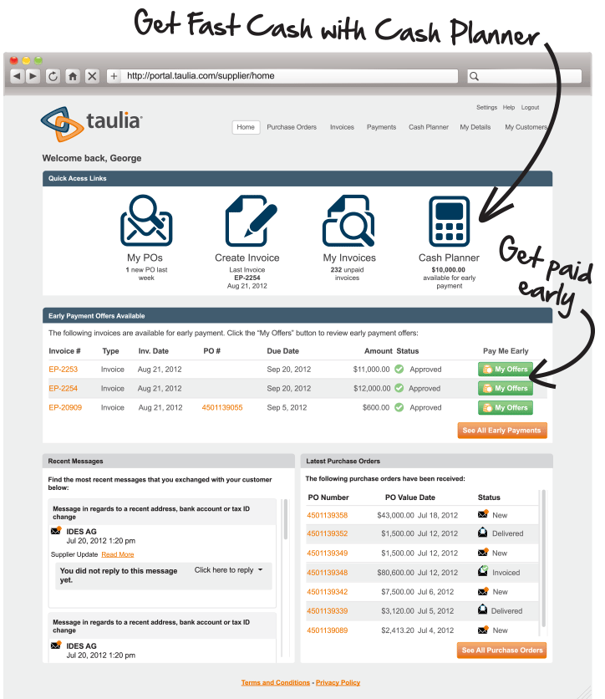
Supplier View

Slide 7
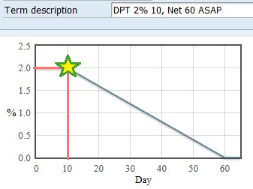
Discounts 2%10NET60, ASAP
2%10NET60, ASAP Example Notes:
ASAP Term:
-Allows discount even after an invoice is approved after day 10
-Invoices approved after day 10 follow sliding scale to 0% on day 60
-Invoice paid at 2% discount on day 10 if approved days 1-10, thereafter paid on date approved at rate determined by sliding scale
Payment: For most US payments, supplier will receive payment the day after a payment is approved in AP but any discount rate applied is based on day AP approves
Discounts Over 2%: Milliken has not turned on this feature, will notify suppliers if change is made.

Slide 8
“Did you check Taulia?”
First line of defense should always be the Taulia portal. There the supplier can find detailed views of:
Invoice statuses
Payment & Remittance Info
PO Details
Create Invoices
Supplier Master Updates
Cash Planner

Slide 9
Enrollment
Who: All suppliers
What is needed: 1) A/R e-mail address
How: Enter A/R email address in Request for New Supplier form

Slide 10
General Information
Overview of Portal: http://supplier.taulia.com/customers/milliken/
Link to Taulia Buyer Portal: https://portal.taulia.com/login
Login: Your credentials.
Taulia Help Contact Information
US/Canada: 1-866-913-8409
E-mail: support@taulia.com
Taulia Help Section (“Knowledge Database”): http://support.taulia.com/forums

Slide 11
Contact Information
Milliken Contacts for Taulia
Project Manager: David Heichemer (david.heichemer@milliken.com)
System/Programming/IT: Brian McGrath
Invoice & Payment Inquiries via Message Board: Donna Haynes & Gina Boyd
PO Inquiries via message board: Milliken Sourcing Administrators

